Slide 1
The Universe of R
Victoria Alers 09/07/2020

Slide 2
TABLE OF CONTENTS
01
02
03
When to use R
R is not always the answer. So when is it?
Data Analysis Workflow
What Packages? How do I set things up for a successful and interpretable analysis?
qPCR Example
Example workflow
Notes:
I’d like to review what I will be talking about today. First lets discuss when R is useful to use. Then Ill talk about how to think through utilizing R for your purposes. Then Ill give you an example of how to go about this workflow by analyzing qPCR results.

Slide 3
When to use R?
Notes:
An often misconception is that computers are always useful however, sometimes pen and paper or another person is more useful.
On that same note, R is not always useful when you are analyzing data.
Contrary to popular belief, bioinformatitions don’t believe Excel is a bad word.
So lets discuss when to use R vs. excel.

Slide 4


When to use R?
➣Quick/Simple one-time analysis
➣Basic statistics
➣Basic graph
➣Large messy data
➣interactive format
➣Complex graphics
➣Data analysis report output

Slide 5




Data Analysis workflow with R
Analyze qPCR results
Understand your question/objective
sketch a workflow
Pick packages
create and debug your script
Notes:
Now that we’ve discussed when using R is useful lets discuss how to utilize it with max benefits.
The first thing to do is KNOW what you are trying to do.
Then sketch a workflow on how you think you can get from your data to the end result.
What type of packages will best compliment your workflow?
Now lets get to the best part. Writing the script and running it.
Remember this sounds simple enough and straightforward. Just know if your not sure during any step of. This workflow know that as you keep going through the steps it will become evident and you will need to circle back to fix/ or better understand your objective or rework your sketch.
Off course if a pipeline/template already exists then that’s your ideal application to use!

Slide 6
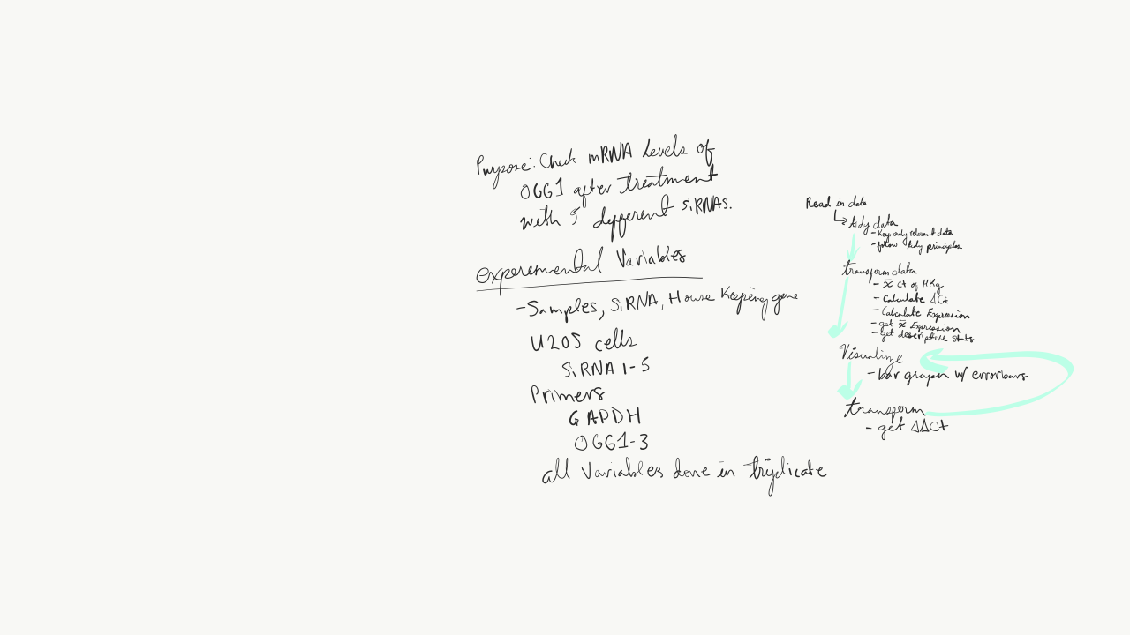
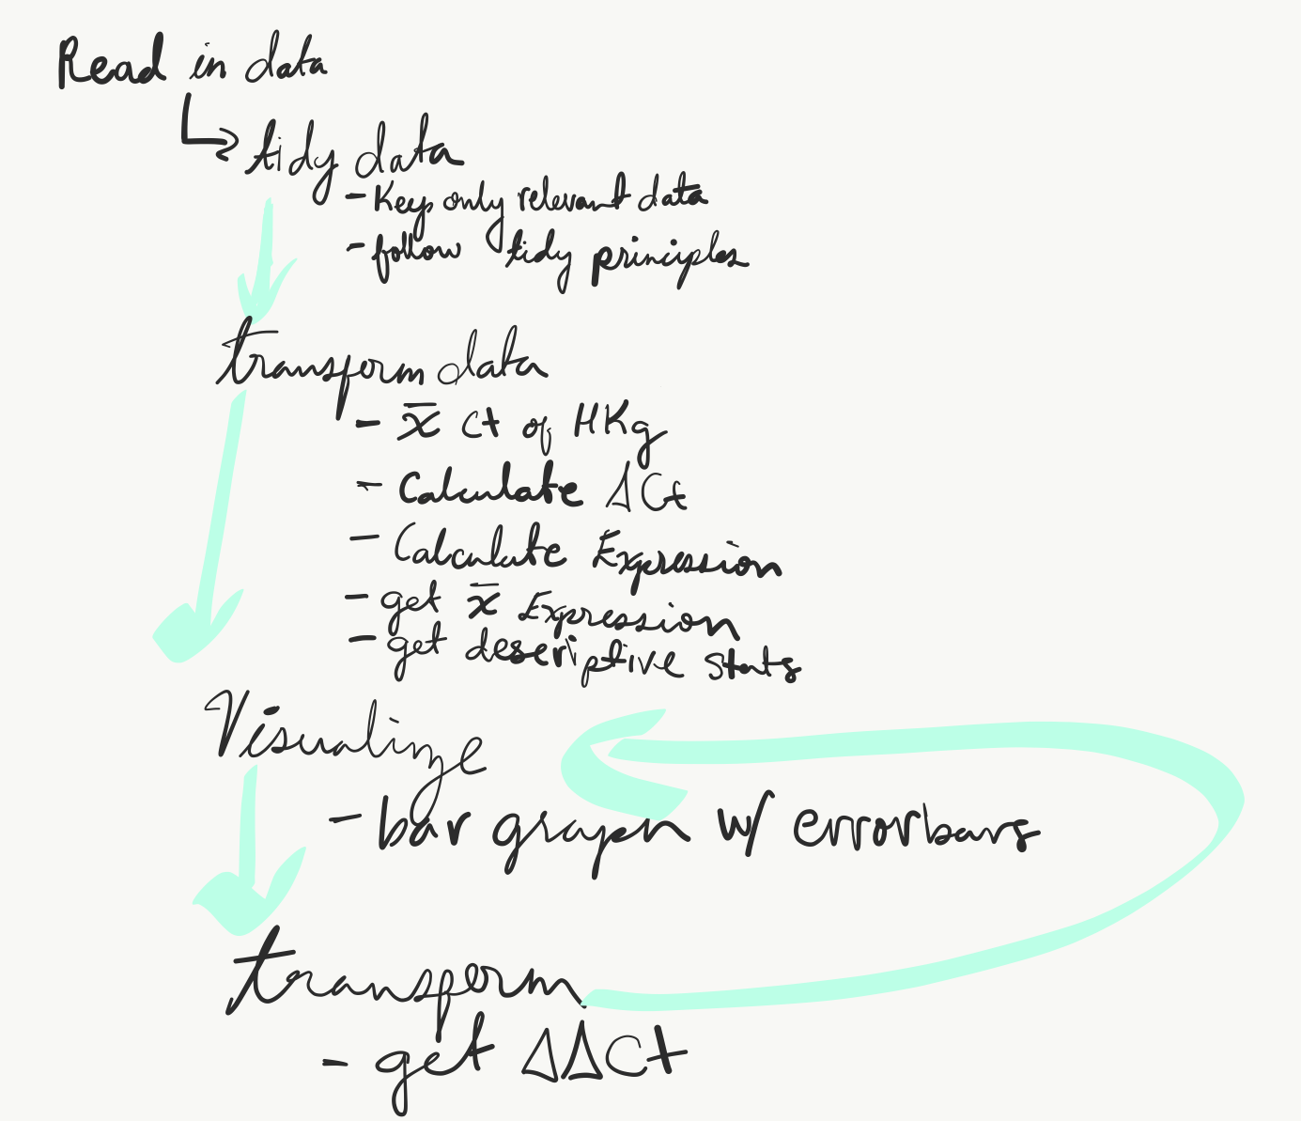
sketch a workflow
Understand your question/objective
sketch a workflow
Pick packages
Execute and debug the script

Slide 7
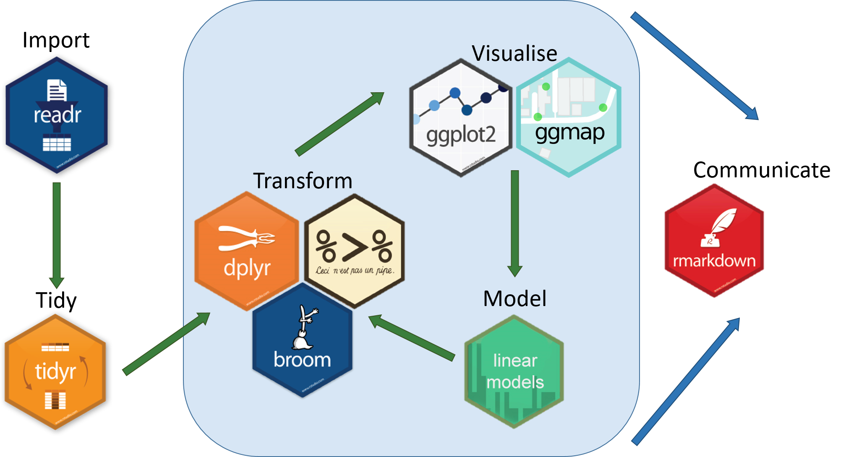
pick packages based on schematic
Understand your question/objective
sketch a workflow
Pick packages
Execute and debug the script
https://medium.com/@kadek/how-to-install-the-tidyverse-r-via-homebrew-macos-10-14-d749d2136cf1

